Slide 1


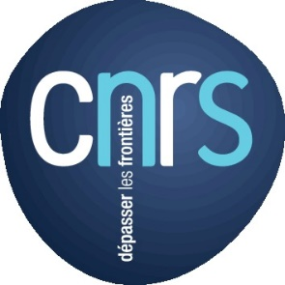


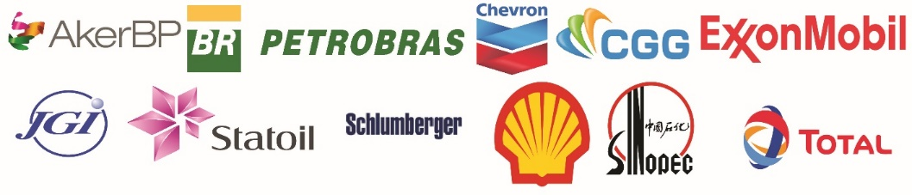
Matter-Wave interation: Earth Crust probing
Master Class Senior ISTerre
Interaction onde-structure: les enjeux de l’imagerie crustale
Une vision partielle de Jean Virieux
Seiscope consortium
Direct contributions from
Romain Brossier (ISTERRE)
Ludovic Métivier (LJK/ISTERRE)
Stéphane Operto (GEOAZUR)
Alessandra Ribodetti (GEOAZUR)
Many other contributions from SEISCOPE’s team (over 15 years)

Slide 2
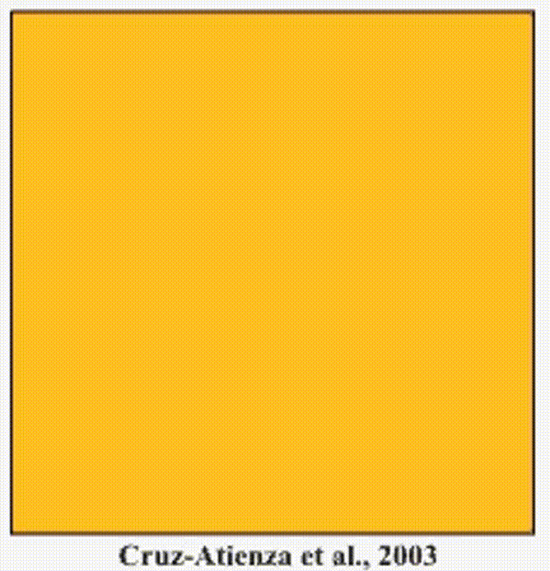
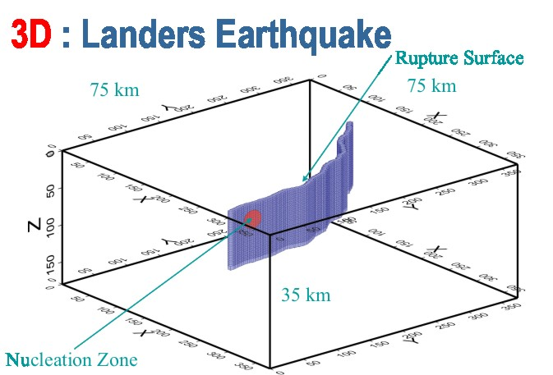
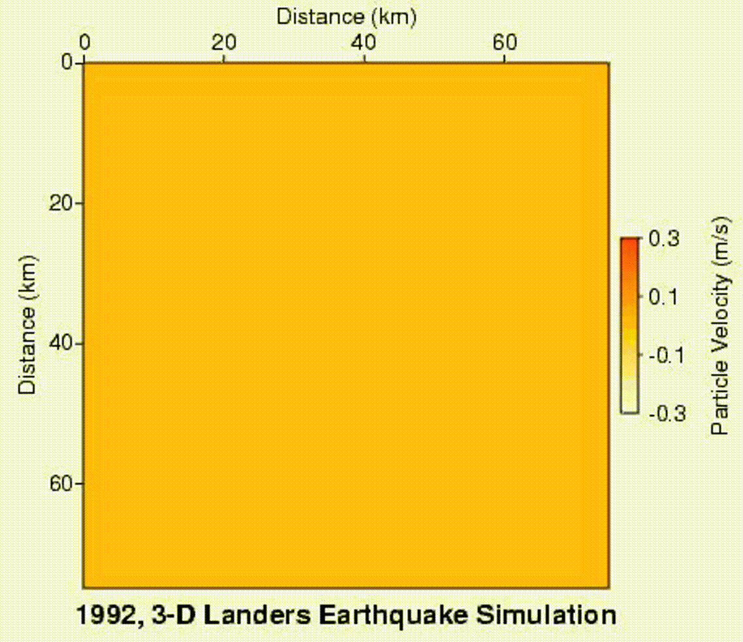
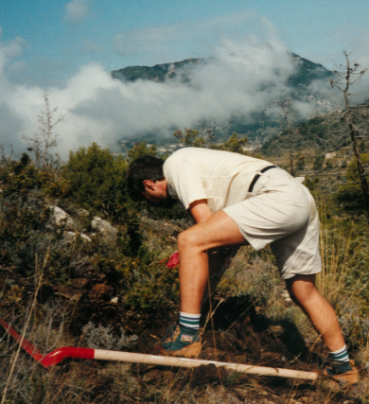
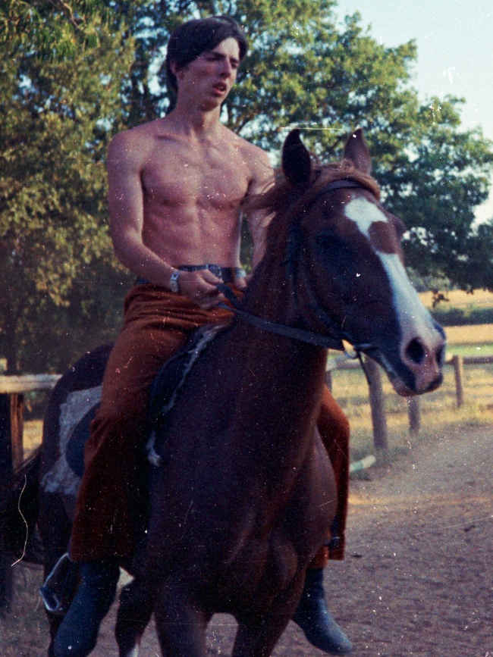
Waves: attractive & vanishing object
My personal scientific interest:
Waves (optical, acoustic, elastic):
unique communication when away
unique probing of hidden objects
very few other left alternatives…
Why Earth Sciences:
& challenging physics: elastic propagation with two speeds
& outdoor activities: key argument for me
Complex wave propagation
work
riding

Slide 3
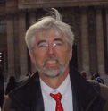
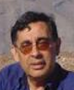
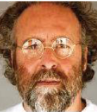
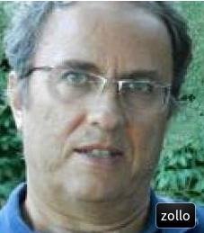
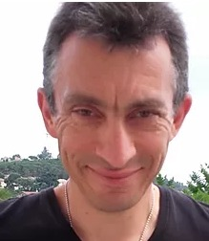
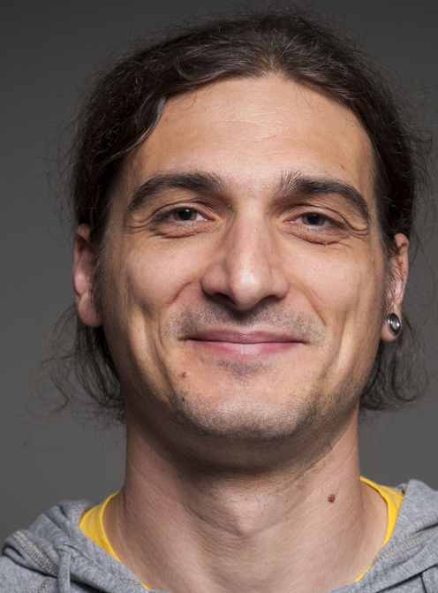
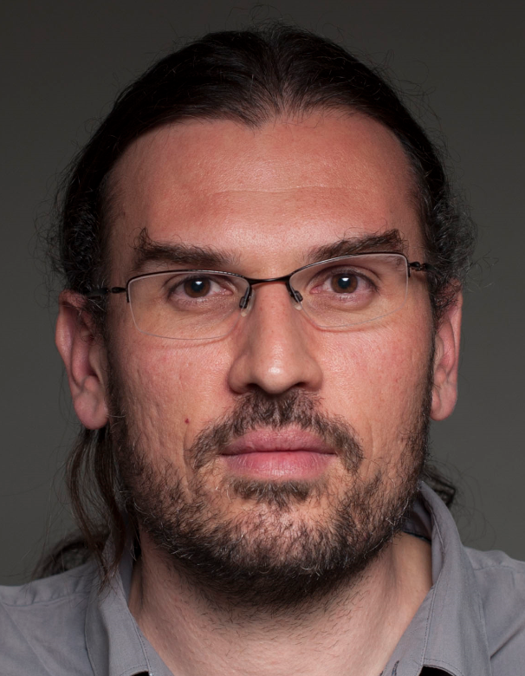
Scientific topics…
PhD topic: earthquake dynamic rupture …
theoretical investigation using numerical tools (specifically FD wave propagation modeling)
No data!
aside output: theoretical FWI
with the consortium « GTG »
Post-PhD: travel-time tomography with many people (still on)
Data! Volcanic area (Mt Vesuvius/ Campi Flegrei nearby Naples) & Rift zone (Gulf of Corinth)
Post-PhD: RAY+BORN imaging with many people (consortium « GRS »)
Data from Oil&Gas enterprises (Elf-Aquitaine – Oseberg field)
Long time after: real applications of FWI (consortium SEISCOPE, still on)
New generation …

Slide 4
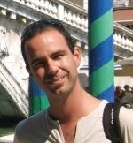
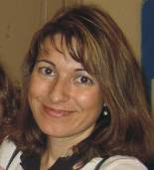

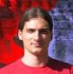

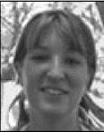

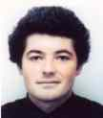
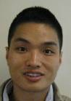
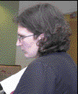
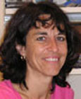
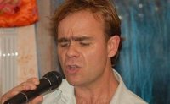
Few Students at GeoAzur …
Victor (2003-2006)
Alessandra (1994 – 1998)
Hafedh (2006-2009)
Romain (2006-2009)
Vincent P. (2008-2012)
Celine (2004-2007)
Bernhard (2000-2003)
Vincent E. (2007-2011)
Guanghui (2008-2012)
Raffaella (1996-2003)
Francoise (1991-1994)
Pascal (après sa reconversion…)
And many others …

Slide 5

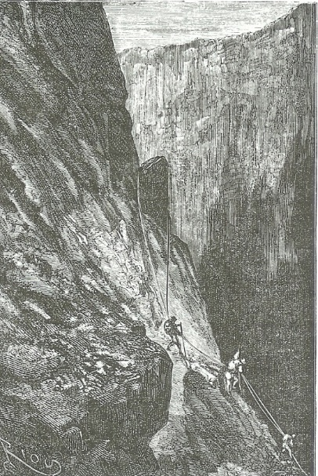
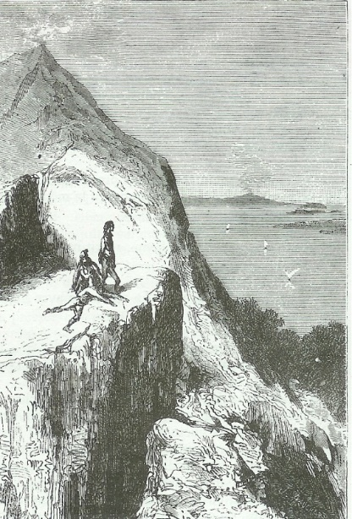
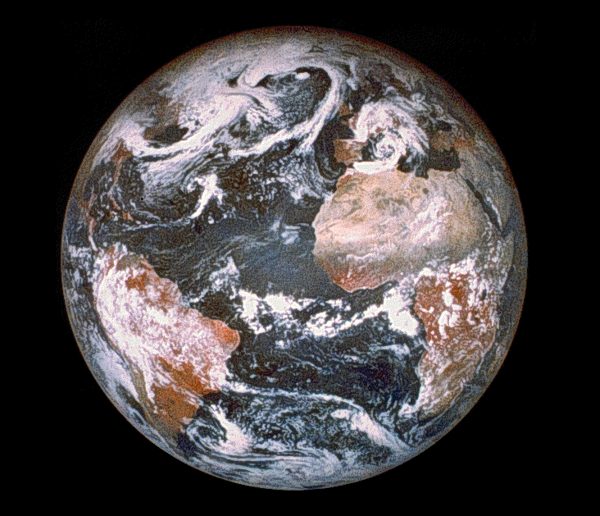
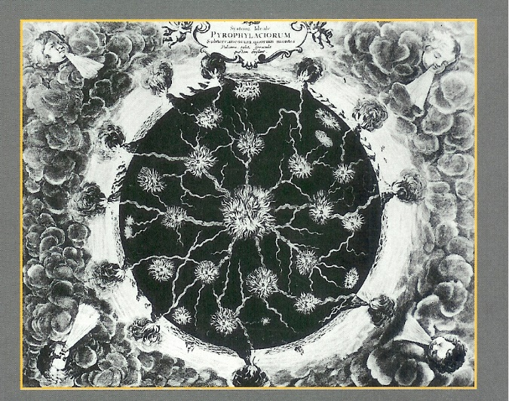
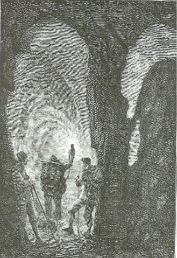
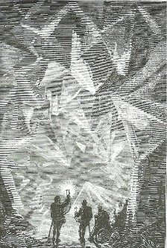
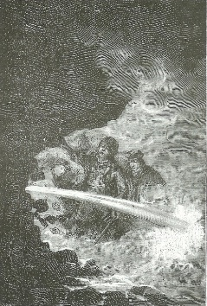
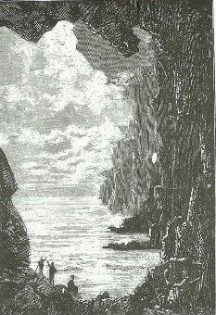
The Earth system: its mysterious interior?
From Snaeffels
Journey inside the Earth
To Stromboli
cavities
minerals
What dID they find?
(Kircher, 1665)
Over-pressurized water
lakes

Slide 6
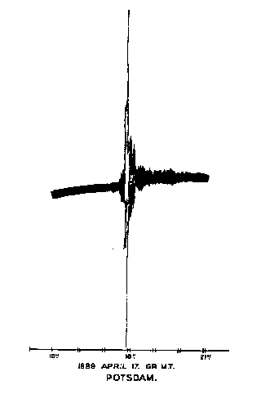
The Earth interior?
Great discovery at the end of te XIX century
Modern seismology was born!
In 1889, a ground vibration in Europe was linked to a Japanese earthquake: waves can travel inside the entire Earth.
Oscillation of a pendulum at Potsdam (Germany)
Telegraph revolution!
Correlation between two far-away objects!

Slide 7
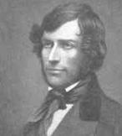
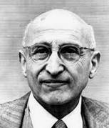
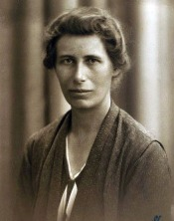
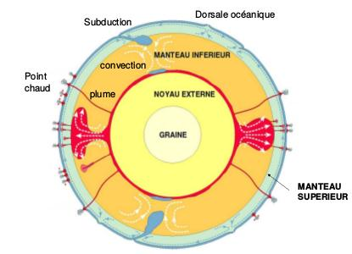
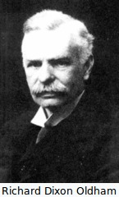
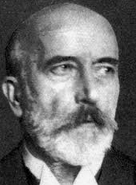
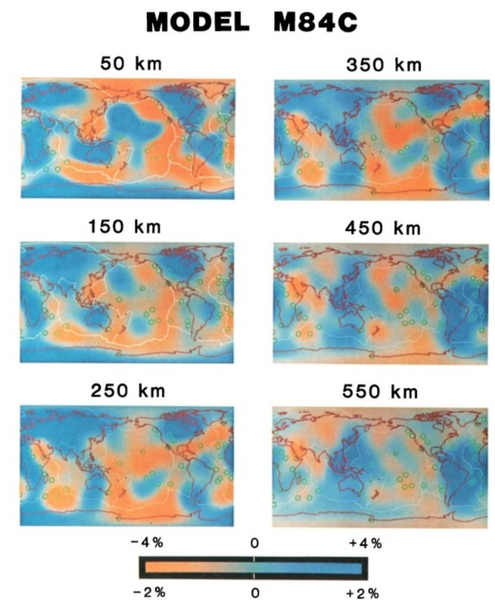
Seismology (including seismics)
Earth interior: qualitative/quantitative issues?
Before 80’s, seismic imaging was based on travel time measurements (direct and reflection signals): radial model such as the PREM model (Dziewonski, 1981)
First paper using amplitude: M84C models of the Earth interior (Woodhouse & Dziewonski, 1984) competing with models based on phase/time data (Dziewonski, 1983, 1984; Dziewonski & Anderson, 1984).
Phase information plays a crucial role

Slide 8
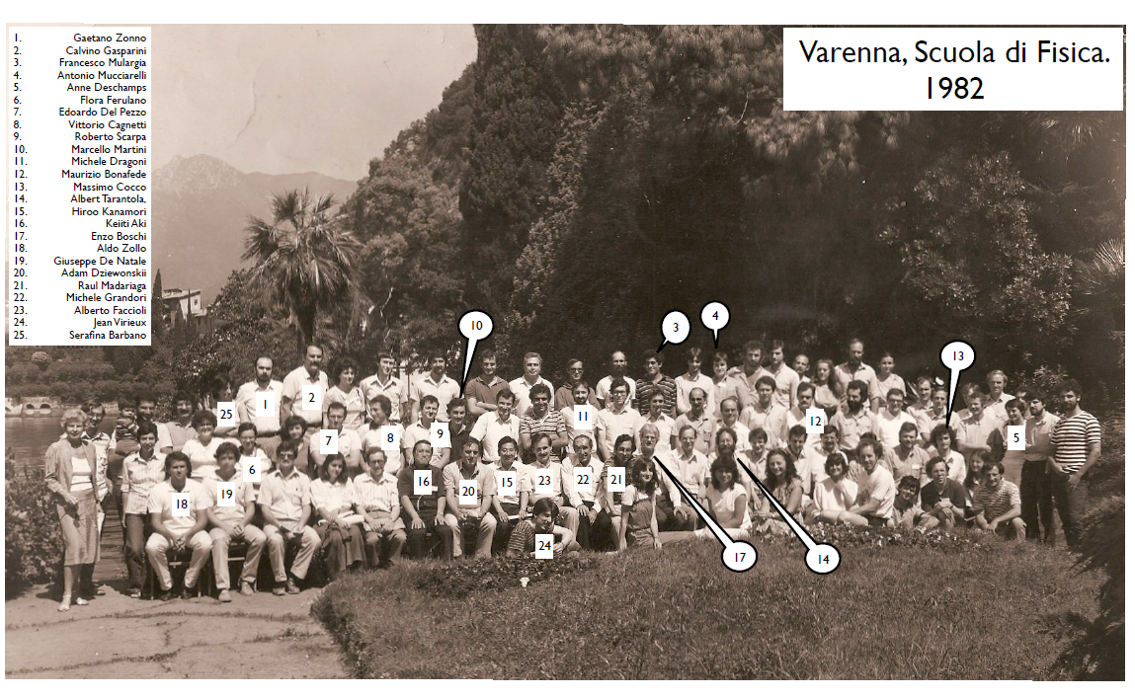
Brain storming from workshops
Message of John Woodhouse
Focus your attention on seismograms (amplitude analysis)!
They carry a lot of information (normal modes summation)

Slide 9
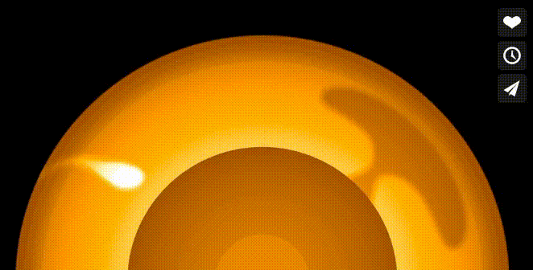
Global Earth: big object but same physics
Focusing targets !!!
Crust: complex nearby object
Mantle: still a rather simple object!
Movie from Stahler & Tarje
CMB: a far-away object
should be much more complex than available images …

Slide 10
The Earth crust: hugh storage capacity?
On the need to image, characterize and monitor the subsurface
CO2 storage: monitoring the Sleipner reservoir …
Reservoir model
Geological structures for giant storage:
Ultimate storage: CO2 sequestration, chemical deposit, nuclear deposit and so
Temporary storage: heat (geothermal targets), H2, CH4, HP gas over year cycling
Seismic imaging: not only a crucial need for Oil & Gas primary resources, but of critical importance for energy demand.
Young generation should be trained on that topic!

Slide 11
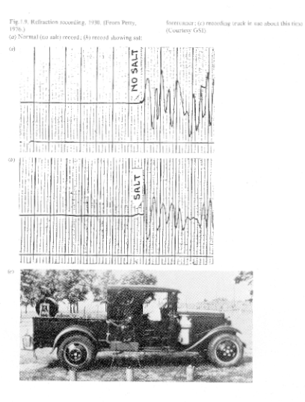
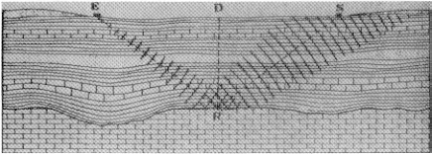
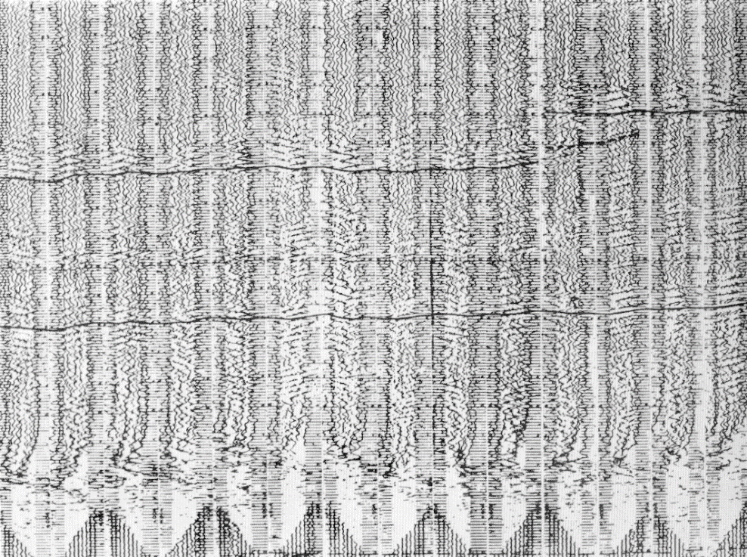
Seismic data: heroic times before 1940
Interpretation cartoon (1921)
Head wave:
Polarity as a salt proxy
Fault detection on paper plots
Three sensors and an acquisition truck!

Slide 12
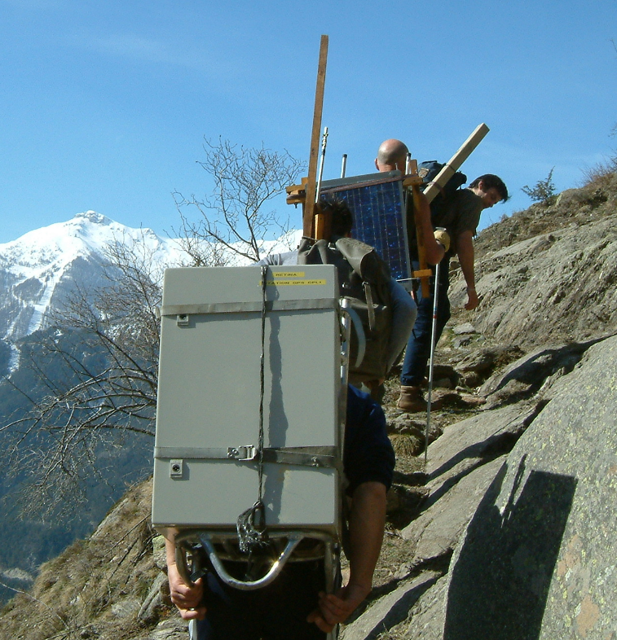
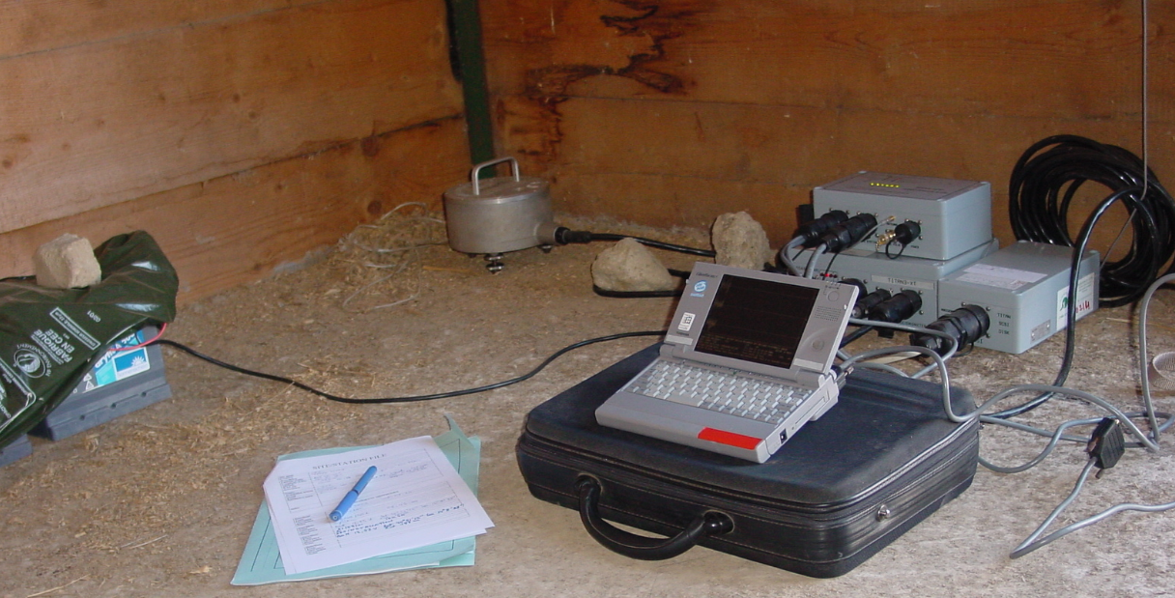
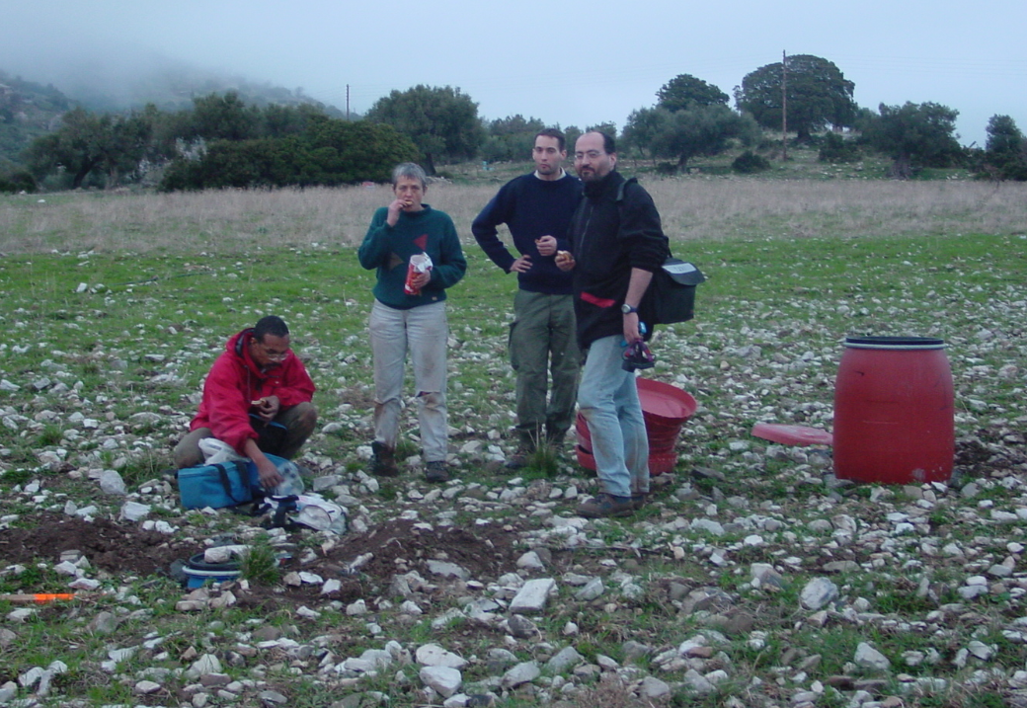
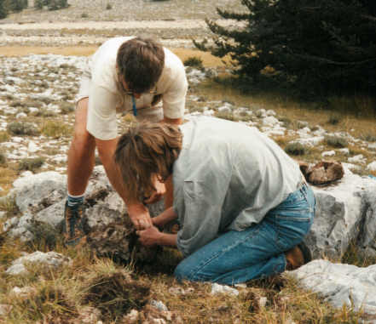
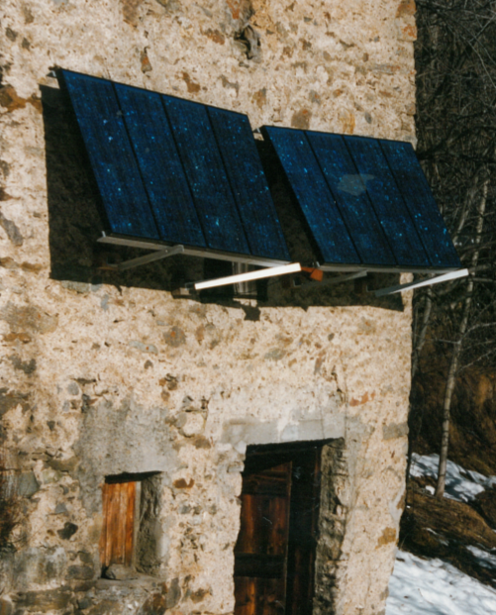
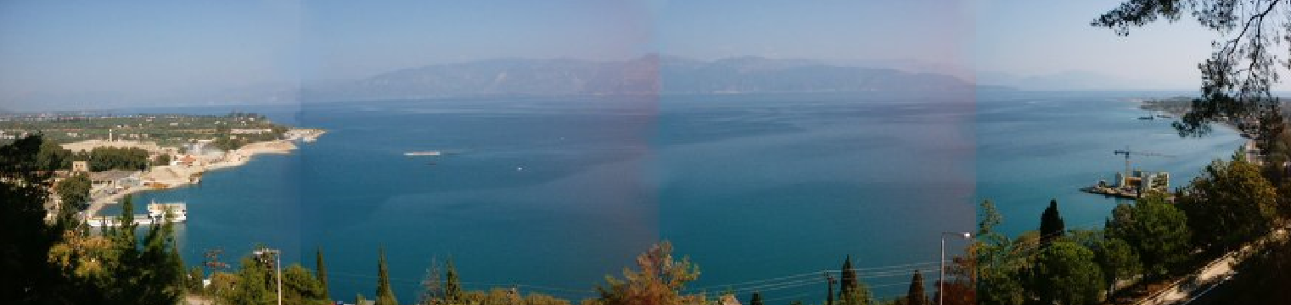




Hard life for field seismologists
sheepfold
but in lovely places

Slide 13







Seismic wave recording … Academic world
Smooking the drum!
Hunting for amplitude variation?
Seismic array on Vesuvius summit!
In Greece summer time!
Radio clock (<1995)
to
GPS clock (> 1995)
My student time
True amplitude
Learning field challenges
Job done but clock synchro. KO!
TGRS: STEF station
in my family village
LALA phase!
A lot of fun, but
take-away lesson: professional experts needed
->
Look at industrial datasets for crust imaging
My research time

Slide 14






Seismic data: modern time
High-quality data with unprecedent density of stations at various scales
USarray
Done!
Valhall experiment:
50000 shots; 2300 receivers
New data?
New interpretation?
New methods?
Alparray
Chinesarray
Beach nodal array (Slater & Hollis, 2012;Li et al, 2018)
Mt St Helens (Hansen & Schmandt, 2015)
Moore ’s Law:
marine seismic channels
Seismics
Seismology

Slide 15





Nowadays
Dense seismic data
High computer capabilities
Sophia Antipolis
How lucky are you?
Better knowledge, better management of underground structures and resources (toward technical sustainability …)
Before (my time) few data and limited computer resources (especially in France):
supercomputer ‘80s ~ Smartphone ‘10s

Slide 16




Expected resolution from seismic data
Real medium
Translucent Earth
Unaccessible target?
Intrinsic remote sensing limitation
Seismic finite frequency & attenuation
Additional information?
Seismic imaging
Travel time information?
Waveform information?
Interpretation?
Beyond seismic resolution:
dictionary learning
How far should/could we go with seismic waves?
Inspired from Romanowicz’s lecture

Slide 17
Seismic data: modern time
Industrial & Academic communities interact more nowadays !!!
Pending question:
Are we extracting all the information
contained in these massive high-cost datasets?
Efficiently, precisely and timely!

Slide 18






Upper crust: the 80’s dream!
Open body (# closed body such as the global Earth: exit normal modes)
No more guitar!
Synthetic model
From French Mathematical Community
Optimal control of parameters investigated by Lions (1968),
Chavent (1974), Bamberger et al (1977), Lailly (1984), and finally Tarantola (1984)
More than ten years for a slow percolation from mathematics to geology …
Odile Gautier
CRAY-1 resources:
Only acoustic case; not enough memory; a lot of I/O (my own virtual memory tool …); few iterations using gradient method …
Reconstructed model using gradient with 5 iterations

Slide 19
Upper crust!
Open body (# close body such as the global Earth: exit normal modes)
No more guitar!
Synthetic model
Solution from French Mathematical Community
Optimal control of parameters investigated
by Lions (1968), Chavent (1974), Bamberger et al (1977), Lailly (1984), and finally Tarantola (1984)
Ten years for a slow percolation from mathematics to geology …
FULL WAVEFORM INVERSION! A dream at that time (1985)
CRAY-1 resources:
Only acoustic case; not enough memory; a lot of I/O …; few iterations using gradient method …
Reconstructed model using gradient with 5 iterations

Slide 20



Back to basics!
Travel-time tomography: phase information of wave propagation
Robust observable based on clock precision (GPS) and not on instrument calibration
Half-century recording
Earth phase events
For mantle tomography
detection/association phase events OK
For crust tomography
overlapping phase events ???
passive tomography (local earthquake tomography)
active tomography (upper crust tomography)

Slide 21
Back to basics!
Warning
You may hear that I am using in a rather equivalent way the word « phase » and the word « traveltime ».
They describe different ways of propagation for dispersive waves. For balistic waves, which are almost non-dispersive, they are equivalent.

Slide 22



Back to basics for three targets!
Naples volcanic structures: Mt Vesuvius & Campi Flegrei:
local earthquake tomography (LET) and active seismics.
More than 20 years of investigation!
Hunting amplitude variation (Oh LALA !!!)
Corinth Rift:
LET 1991 (H. L-C), 2001 (3F-Corinth F.C. & I.M.) -> CRL (P. B.)
Two seismic temporary experiments before permanent network
Viking Graben (Oseberg field of Norway) : active seismics
(Ray-Born Imaging) 1992 (R. Madariaga consortium GBS
supported by Elf-Aquitaine and CNRS)

Slide 23



Simple questions and difficult answers!
Mt Vesuvius & Campi Flegrei: are these volcanic systems connected at depth?
Corinth Rift: extension interpretation?
Viking graben: fluid migration?
Seismic data and interpretation aside other geological, geochemical and geophysical data … (no black/white answer)

Slide 24

Related hierarchical structure of the crust
Two scales show up in the model reconstruction
Recorded seismic traces bring different information from medium properties

Slide 25




Seismic imaging workflows
Phase (traveltime for non-dispersive wave) drives imaging
Quantitative model?
Velocity based on waveform
Data
FWI
LSRTM
low-k
high-k
RTM
or
PDM
Qualitative model?
Reflectivity based on migration
Macro-model based on velocity analysis

Slide 26








Wavepath: sensitivity kernel
From transmission information (velocity analysis) …
$$\sqrt{λL }$$
$$\frac{λ}{2cos⁡(\frac{θ}{2})}$$
Inverse of Kz
… to reflection information (migration,fwi)

Slide 27
Global Earth: probing # objects
Crust and Transition zone (CMB) are two expected complex targets
Crust: combined transmission and reflection regimes
and all intermediate regimes
Mantle: only transmission regime for now on!
Movie from Stahler & Tarje
CMB: mainly probed by waves through transmission regime
while expecting more complex interaction!

Slide 28





Velocity Analysis: a robust method!
Kinematic correction:
NMO velocity
Macro-model reconstruction
Common source profile
CSP
Common midpoint profile
CMP
NMO velocity: estimation based on
the identification of hyperbolae lines of reflections
Offset X
indicatrice
$$T_{x}^{2}=T_{0}^{2}+\frac{X^{2}}{V_{nmo}^{2}}$$
Wave-matter interaction:
Transmission regime based on reflection events

Slide 29


Hierarchical structure of seismograms
In the Earth
Three time scales (for balistic waves)
Three spatial scales …
Two options:
extracting specific observables (time/phase)
using records as they are (calibrated amplitude!)
Seismics
Seismology

Slide 30

Option A: phase information
Extracting specific observables from records
Kinematic observables (as for oceanographic and infrasonic tomographies)
- times or (instantaneous) phases (used in seismic time tomography)
- angles (back-azimuth and slowness angle: source, receiver, diffractor)
- time curvature (example of velocity analysis)
Correct physical description of time/phase data
Tools for predicting accurately these observations
Dynamic observables (option A+)
- (Instantaneous) envelopes
- amplitude decrease with offset (AVO)
- amplitude decrease with frequency (attenuation – broadband records)
Correct physical description of amplitude variation
Tools for predicting accurately these observations
T* tomography

Slide 31

Corinth tomography
PhD of Diana Latorre (2004)
Vp/Vs image deduced from the Vp and Vs tomographic models
Vp/Vs value may discriminates lithology.
Variations depend on porosity and fluid saturation.
Fluid combined with soft material may help sliding a thick block over another one. The tilting mechanism is not mandatory (the extension factor $β$ of oceanic margin)

Slide 32


Corinth tomography
?

Slide 33



Oseberg Ray+Born imaging
Macro-velocity model built from velocity analysis …
?
Data
Lambaré et al (1992)
Energy has been removed …

Slide 34


Puzzle of Napolitean volcanoes
?
Tomoves-1996
Serapis-2001
A long-term adventure
by Aldo Zollo … and many people
Vanorio et al (2005)
The 1982-1984 bradyseismic crisis
Passive and active seismic experiments
Three attempts for amplitude interpretation
on this target: we partially succeed!

Slide 35


Progress in traveltime tomography
Traveltime tomography: still strongly based on 90’s methodology (as far as I can see) …
small computer requirement …
Questions:
why images are so smooth!
how to use differential information (DD strategy)!
debates regarding theoretical features (understanding)!
Grand-daddy research
Full waveform inversion: intense search activity
many groups are involved …
HPC implications …
Fashionable research

Slide 36


Seismic imaging: phase versus wave
Wave equation
Linear PDE
Eikonal equation
Non-linear PDE
Ray equation
Non-linear ODE
Helmholtz solution
only sum!
(Runborg, 2007)
Both but singular or shadow!
Traveltime tomography cannot consider beating waves!
Full waveform inversion does!
No free lunch: not only computer resources but possible leakage between model parameters (speed versus attenuation, compression versus shear interpretation and so on … anisotropy, acoustic approx.)
as well as wave-equation traveltime tomography
(Almomin & Biondi, 2012; Li & Chauris, 2017; Sun et al, 2017; Djebbi & Alkhalifah, 2020 …)

Slide 37


Banana-Doughnut debate
https://www.geoazur.fr/GLOBALSEIS/nolet/BDdiscussion.html
(Dahlen et al, 2000; Dahlen & Nolet, 2005; Nolet, 2008)
Phase/time tomography based on Eikonal does not provide the so-called BD shape promoted by Dahlen & Nolet … !!!
Such shape is related to ray concept (and not to the time/phase concept for which the zero-sensitivity along the ray does not exist)
Many authors have tried to understand better this theoretical contradiction …

Slide 38

My understanding of this debate
When considering phase information
DIFFRACTION EFFECT NOT INCLUDED IN RAY APPROACH
DIFFRACTION EFFECT CAN BE INCLUDED IN THE SO-CALLED EIKONAL APPROACH
RAY SK
(From Djebbi & Alkhalifa, 2014)
EIK. SK
Outcome of this debate: is it really important for applications?
My negative option (2014) has moved to a more positive one (2019) …

Slide 39

Projection of gradients on discrete model
Eikonal=Adjoint
(Bretaudeau et al, 2014)

Slide 40
Projection of gradients on discrete model
No differences on coarse grid:
safe situation on most cases
for sparse acquisition
(Bretaudeau et al, 2014)

Slide 41



Dense acquisition
Dense array: is it still true?
Ray SKs
Toy example:
topography taken as velocity perturbation
(mimicking HF pattern)
Rays: same value (ray length) of the sensitivity (velocity impacts only the ray path itself)
Eikonal SK exhibits more complex pattern: variable values along the trajectory !!!
Adjoint=$Σ$ Eikonal SKs
SKs: different values with possible different paths before reaching the station

Slide 42

SKs

Slide 43




Eikonal: a more general concept?
(Runborg, 2007)
A non-familiar interpretation of phases
(often associated to HF approximation)
Wave disturbance (field discontinuity)
valid for any media
single value and always an answer
observable: continuous wavefronts
speed
wave
First phase
(initial wavefront)
source
but discontinuous derivative
Eikonal
Line of same dansers
Wavefront: particles moving a synchronized way. They are in phase.
(Le Bouteiller, 2018)
Diffraction effects included $(u∝ω^{1/2}$)

Slide 44


Eikonal (time/phase) sensitivity kernel (SK)
(Le Bouteiller, 2019)
RD:
SK field
Reverse differentiation gives Eikonal sensitivity kernels:
where to insert velocity anomalies to match time data (sum of kernels over receivers) (Taillandier, 2009; Lelièvre et al, 2011; Tavakoli F. et al, 2017, 2019; Sambolian et al, 2019, 2021; Tong, 2021)
Sensitivity kernel defines zones of velocity perturbation affecting the time/phase at the receiver (regardless of the frequency content of waves!)

Slide 45

FD & RD perturbation versus ray perturbation
Forward differentiation (FD): slowness perturbation -> time perturbation
For a given point $x$, $δu\left(x\right) →δT\left(.\right)$ everywhere
Reverse differentation (RD): time perturbation -> slowness perturbation
For a given point $x$, $δT\left(x\right) →δu\left(.\right)$ everywhere
Ray linear relation
$$T\left(x,u+εδu\right)=T\left(x,u\right)+ε\int_{source}^{receiver}{δu dl}$$
i.e. time residual at a given station
Locally, the ray sensitivity is the length of the ray inside the cell of the grid
only a geometrical value: arclength

Slide 46
Dense acquisition
Traveltime tomography
How to take benefit of such density?

Slide 47

Back-azimuth observables
DATA
CIRCLE
RAY
SEM
For 4 earthquakes,
measured arrival angles across the USArray network &
predicted angles for a S362ANI model using
(1) great-circle approximation,
(2) ray tracing and
(3) SEM modeling (interference issue)
Observables have more information than
those predicted by built Earth models
Figure 7 from Foster, Ekström & Hjörleifsdottir (EPSL, 2014)
Improving tomographic approaches for honoring both traveltimes (or phases) and azimuthal (and/or slowness) measurements?
(Hu & Menke, 1992)
(Yanoskaya, 1996)

Slide 48


Dense acquisition
Slowness & back-azimuth observables
for Wenchuan 2008 earthquake
SEAA: sub-array of 16 sensors
station SEAA
ChineseArray
Slowness=ray parameter=slope
Azimuthal angle and apparent slowness
(from figure 16 of Hu, Zhang & Yu; GJI 2019)
Increasing density of stations offer us new observables such as slowness and back-azimuth observables aside traveltime observables (nonlinear time series analysis)

Slide 49
Option A+ and Option B
Using dynamic observables (option A+)
Or
Using records as they are (option B)
Deep understanding of the wave propagation physics (PDE?)
High-quality data: reinforced acquisition protocol
Accurate prediction of true wavefields (beyond waveforms)
Another story, next time

Slide 50



Migration versus FWI: linear vs non-linear
Migration: an efficient linear process with always an answer you may like it or not (interpreters are key experts). (very robust to amplitude errors)
FWI: a costly non-linear process with often no answers!
This makes students rather frustrated… (amplitude influence)
(easier life for interpreters ☺)
FWI: when it works (needing not only smart students but high-quality data), potential quite interesting interpretation with physical quantities!
Final goal of deterministic seismic imaging
(not yet crust/reservoir characterization)

Slide 51

Seismic imaging: small step to rock physics
Model # Medium
No prior scale separation!
From Dupuy’s PhD (2011)

Slide 52
Main take-way message
Crust is a complex body where waves interact with matter with # illuminations
Propagation in the crust may go beyond simple partial differential equation modeling.
Kinematic observables: robust measurements (improved quality, thanks to multiscale arrays!)
Zeroth-order robust physics (accurate modeling of rather stable wave propagation quantities)

Slide 53
Take-away message
Room for progress in kinematic tomography (times, angles, time curvature)
Dense arrays: new imaging approaches (time reversal concept of Claerbout)!
Mitigating the curse of computer resources opening the road to UQ ….
For kinematic tomography, we should proceed with the same effort than the one devoted to FWI since the beginning of this century
Could also help FWI to the right path of imaging
(especially for multiple parameters): another story ☺

Slide 54


A chance for next generation
Massive data
Computer resources
How lucky are you?
Smart (and well-trained) people for mastering these data with sophisticated and efficient approaches
For better knowledge of the shallow crust of the Earth (needed for our modern society)
Subsurface should not be our garbage can … but the unique place for resilient storage!
How responsable you are!

Slide 55



End …
Many thanks for this masterclass initiative giving me the opportunity to draw potential research topics on kinematic attributes tomography without disregarding dynamic attributes inversion …
Many thanks to sponsors of the SEISCOPE consortium supporting FWI research,
Thank you very much
For your attention
Questions?

Slide 56

FWI: the dream …
Broadband sources
Complete illumination
of targets
The dream …
Merging the velocity-model building and the migration into one integrated task when considering full waveforms
Continuous sampling of the wavenumber spectrum and filling the intermediate wavelength gap.
Tarantola (1984, 1987)

Slide 57






Amplitude: essential contribution
Low frequency information
2D synthetic example
Pratt & Brenders (2004)
from G.Pratt
Benefit from waves, even when phases interfere
exact model
1 – 7 Hz of data!!
3D real example:
Valhall oil field
Operto et al. (2013,2015)
(Warner et al., 2008; Sirgue et al., 2010 …)

Slide 58
SKs

Slide 59


Dense acquisition
Traveltime tomography: resolution!
Alps Zone:Traveltime tomography
Seismic networks become denser and denser!
Picking strategy: manual, automatic?
Other kinematic observables:
slowness and azimuth angles?
or more!
CIFALPS profile (CC’)
I am running now this 90’s tool over 1 500 000 picks coming from 30 years of data on a PC (big thanks to many people) for these manual picks)

Slide 60
On the use of FD & RD
Travel time tomography: we need
Eikonal solver (time; non-linear PDE)
RD solver (time SK; linear PDE) (often approximated by rays!)
« Slope » tomography (based on time and time gradient): we need
Eikonal solver (time; non-linear PDE)
RD solver (time SK; linear PDE)
FD solver (time gradient; linear PDE)
RD solver (time gradient SK; linear PDE)
sometimes known as polarization tomography
using backazimuth measurements (arrays!)
90’s tentatives got poor impacts…

Slide 61
Dense acquisition
Picking strategy: industrial expertise
Automatic strategy was mandatory for industrial datasets (80’s!)
Massive Dense volumetric time & slope picking strategy
for reflection traveltime tomography (beyond velocity analysis)
Automatic strategy is fastly percolated intho academic seismological community with increasing dense networks
From manual strategy (SEISAN software?) to automatic one (but often single-station with xC components) picking strategy (EarthWorm software?) for academic datasets (00’s)
Local arrays with few sensors (at least one 3C and many 1C):
9C = 3C + 6 1C seems to become a standard in seismic microzoning

Slide 62

Dense acquisition
Picking strategy: impressive progress
Very exciting novel methods based on
unsupervized or supervized machine-learning approaches
From a WS at LANL (2021)
S.M. Mousavi & G. Beroza (ArXiv:1912.01144v1, 2019)

Slide 63

FWI: using records …
Full Waveform Inversion
FWI
No prior identification ->
No prior scale separation!

Slide 64
Seismic imaging workflows
Phase (traveltime for non-dispersive wave) drives imaging
Quantitative model?
Velocity based on waveform
Data
Phase (travel-time) is still the robust ingredient
for high-resolution seismic imaging
FWI
low-k
LSRTM
high-k
RTM
or
PDM
Qualitative model?
Reflectivity based on migration
Macro-model based on velocity analysis
ACRONYMS FOR FWI VARIATIONS: AWI, WRI, TFWI, EWI, JFWI, MBTT, AEWI …

Slide 65
Option A+ and Option B
Using dynamic observables
Or Using records as they are
Acquisition design (source & receiver positioning & orientation?)
Time synchronization (GPS now! Clock precision < 1 ms -> 0.1ms)
Amplitude calibration (instrument!; installation coupling!)
relative values more than absolute values (still not differential)
(wavefield -> waveform) relaxes installation & experimental procedure !
Source knowledge (source signature; radiation pattern)
quite challenging for natural sources (earthquakes: focal mechanism)
still difficult for active sources (shots, blasts: source signal s(t))
(wavefield -> waveform) mitigates these issues
Deep understanding of the physics of wave propagation
Tools of accurate prediction of waveforms (wavefields!)

